Slide 1
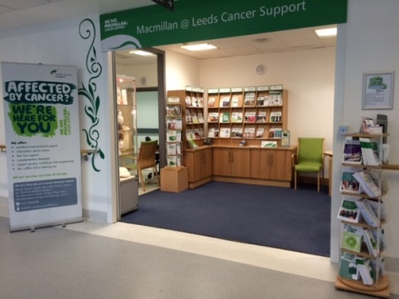
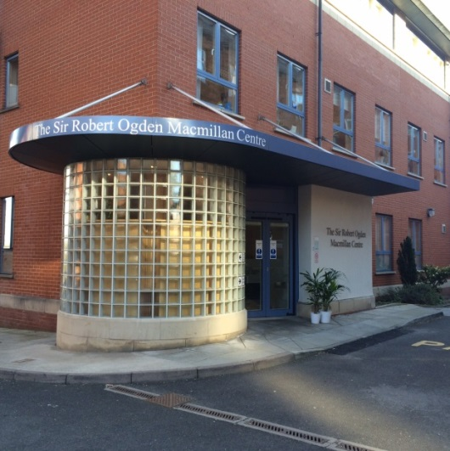


Are you coming for treatment to the Leeds Cancer Centre (Bexley Wing)?
Do you have questions or need support?
Leeds Cancer Support Information Centre
We can be found on Level 1 in the Bexley Wing. We are open for face-to-face advice Monday - Friday and we have a vast array of information resources available, free of charge, including publications and information from Macmillan Cancer Support and other charities. We signpost to local and national services and organisations.
Sir Robert Ogden Macmillan Centre
We are currently offering
Telephone support & signposting including benefits advice
Hair loss support service
Complementary therapies
For more information, contact us or visit one of our Centres
Monday to Friday - 9am - 4pm
Email: Leedsth-tr.Cancersupport@nhs.net
The Sir Robert Ogden Centre - Tel: 0113 2066498
Macmillan Information Room - Tel: 0113 2068816

